Slide 1

Carmeets application
COS491 – Senior Project I
/Gabriel Stoyanov/

Slide 2
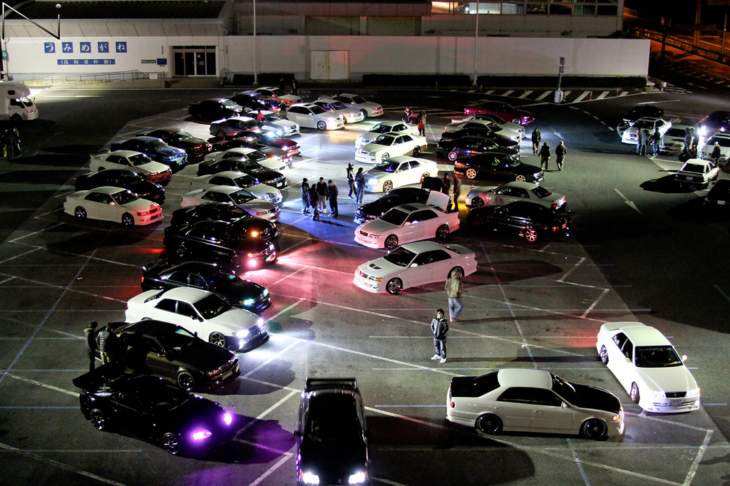

Slide 3
Application components
Android Application
Database System

Slide 4
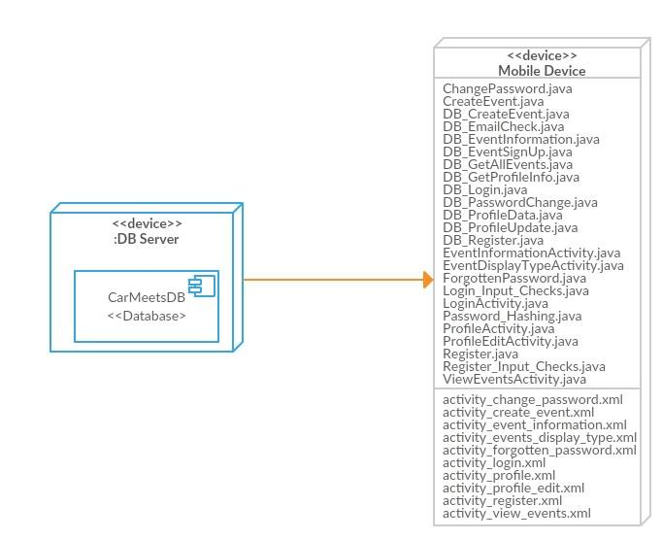
Deployment diagram

Slide 5
Functional requirements
The application is limited to registered users only – non-registered users will not be able to use the application, since they will not be able to proceed past the login screen.
Data must be entered correctly before submitting any requests towards the PHP’s queries – no blank boxes and incorrect data allowed.
The application should provide the user with the ability to recover his or her password through the ForgottenPassword activity.
The application should correctly authenticate the user.
The application should correctly encrypt the user password when sending a login request to the database.
The application should correctly decrypt the password when receiving a login response from the database.

Slide 6
Functional requirements
The application should correctly compare the password that was entered by the user and the password that was passed as a response by the database.
The application should correctly populate the textboxes in the ProfileEdit activity.
The application should display the appropriate events when requested by the user.
The application should correctly update the database with the new event that the user specified.
The application should correctly display the profile information after signing in.
The application should correctly sign up a user for a specific event that he or she requested.
Requires internet connection in order to modify and extract data from the database.

Slide 7
Non-functional requirements
(Performance) Query executions themselves should not take more than two seconds to be executed.
(Performance) The transitions between the activities should not take more than two seconds.
(Portability) The application should run on all android devices that were produced no later than two years ago and have the latest software updates (Tested on Android 6.0.1).

Slide 8
constraints
The application will not run on devices that are not using android operating system

Slide 9
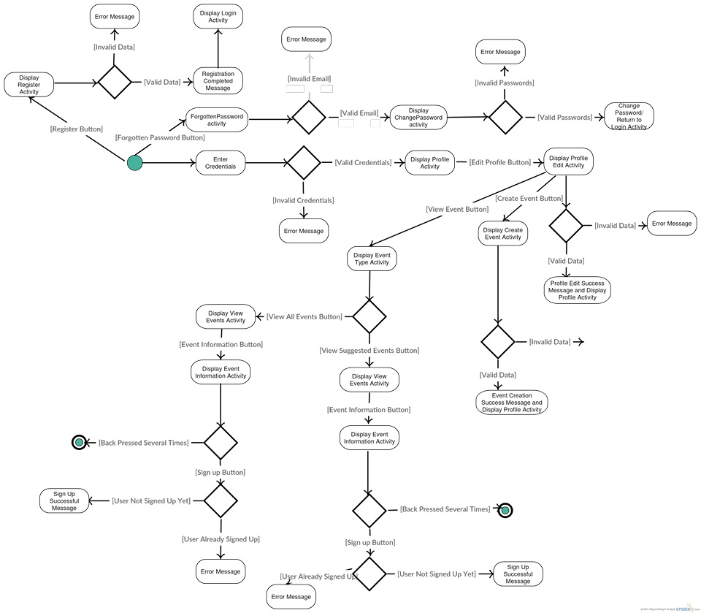
Activity diagram

Slide 10
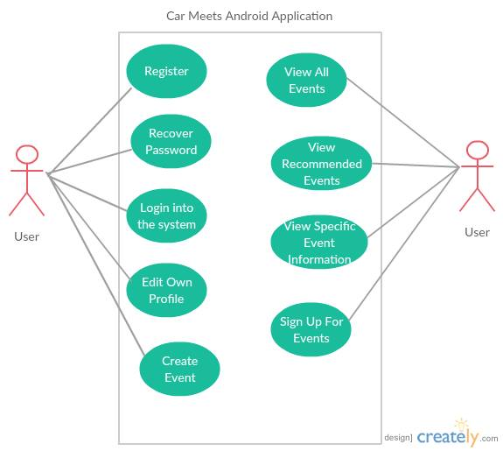
Use case diagram

Slide 11
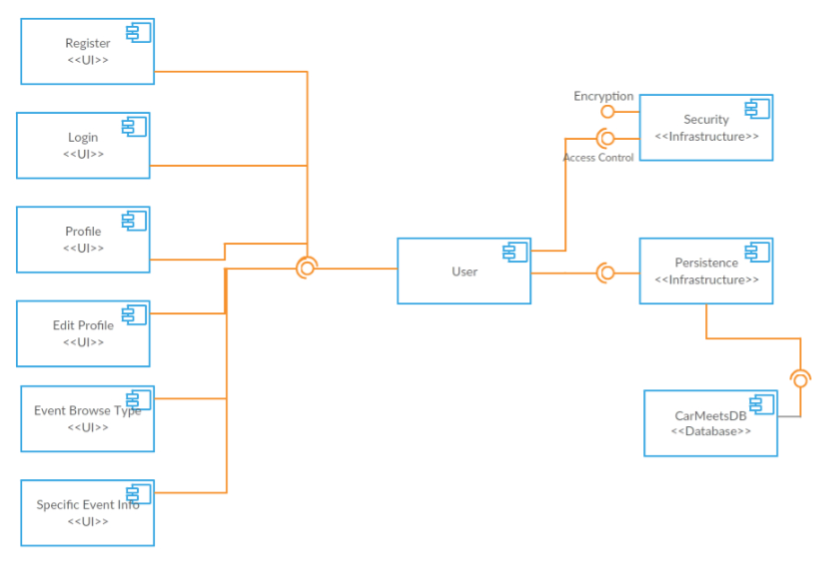
Component diagram

Slide 12
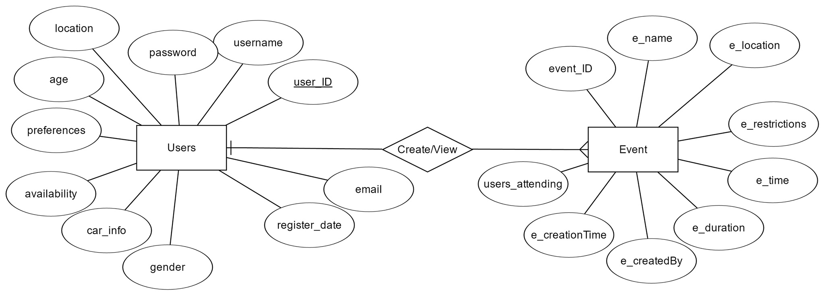
ER Diagram

Slide 13
Demonstration

